Slide 1
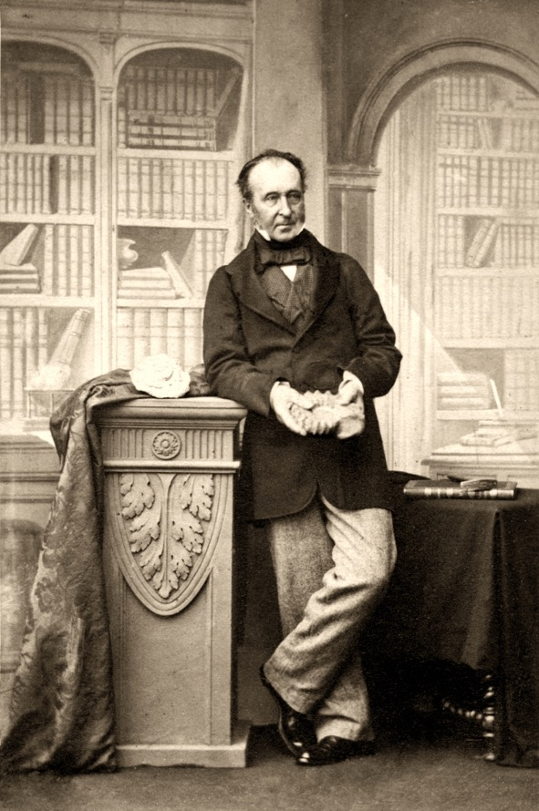
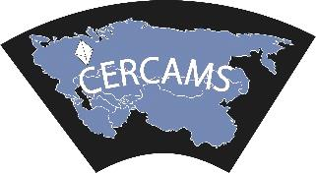
In the footsteps of Murchison: British geologists in the Urals Professor Richard Herrington Head of Earth Sciences, NHM London
October 27th 2017

Slide 2
Sir Roderick Impey Murchison KCB DCL FRS FRSE FLS PRGS PBA MRIA
Roderick Impey Murchison was born 22nd February 1792 in Tarradale, Easter Ross, Scotland and was educated at Durham Grammar School and the Royal Military College
When Murchison met his future wife Charlotte Hugonin (1788-1869) in 1815, she was studying science while he was far more interested in hunting and horses!
After many years of encouragement from Charlotte and latterly Sir Humphrey Davy, the Murchisons moved to London in 1824 where Murchison began to attend lectures on geology and chemistry
He was never formally educated in geology

Slide 3
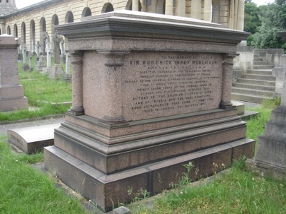
Sir Roderick Impey Murchison KCB DCL FRS FRSE FLS PRGS PBA MRIA
He was elected a Member of the Geological Society on 3 December 1824 twice serving as President between 1831-1833 and 1841-1843
He was knighted in 1846
He was awarded the Geological Society’s highest award, the Wollaston Medal in 1864 and through his bequest established the Murchison Medal and Murchison Fund
Died in 1871 and was buried in West Brompton Cemetery, London close to the Natural History Museum

Slide 4
A man of great ambition..
He served as Foreign Secretary of the Geological Society in 1828
For many years he was on the council of the Royal Society, also he was a trustee of the British Museum
He was a founding member of the Athanaeum Club, the Royal Geographical Society and the British Association for the Advancement of Science
These societies played a major role in directing scientific work, at a time when government involvement did not go far beyond naval mapping and some surveying for strategic materials during times of war
Murchison’s main geological achievement lay in determining the order of the older Palaeozoic rocks, which he described in his first book on the subject, ‘Silurian System’ (1839)
He also went on the name the ‘Permian System’ in late 1841 after his expeditions to Russia

Slide 5
A man of influence
He became an effective advocate for science to an Imperial British government
Supported free trade and peaceful international relations, opposed ‘military adventure’ like the Crimean war
Although a typical Victorian gentleman, he encouraged the full participation and recognition of women in scientific societies
He was a founding father of geological science and geographical exploration becoming president of the Royal Geographical Society and Director-General of the Geological Survey in addition he became Director of the School of Mines in London
He was a patriot but a real European scientist who believed that science transcended national boundaries
He linked geology with geography and his most famous quote is: ‘physical geography and geology are inseparable scientific twins’

Slide 6
A man of science
By the year 1839 Murchison had mapped and described the four groups that made up his Silurian System, defining each on the basis of fossils he had collected during five years fieldwork in South Wales and the Borders
Murchison extended his Silurian terminology into his friend Adam Sedgwick's domain of the Cambrian and this caused a big scientific argument
The dispute over these two Systems continued after the deaths of the two chief contestants
British geologists remained in opposing camps until the end of the century, when Charles Lapworth's Ordovician System of 1879 was generally accepted as a compromise for the disputed strata!

Slide 7
A man of adventure
Murchison focused his attention on Russia and started to built a network of support from Baron Brunow, the Russian ambassador in London
He was very forward thinking in developing a collaborative expedition group - Frenchman Edouard de Verneil, Estonian Russian, Alexander von Keyserling and Nikolai Koksharoff a Russian army officer and mineralogist from the Urals
In 1840 his initial Russian trip was an officially endorsed international excursion, the second 1841 was personally sponsored (and financed) by the Czar
On his second trip, the Czar asked him about the state of the School of Mines in St Petersburg: ”the system seemed to be excellent; that many of the specimens in mineralogy were unique, and that the geological collection was fast improving”
Murchison’s intentions were to extend his work on the Palaeozoic into the limits of Europe, the Russian authorities also wished to understand the state of the empire and its resources to the northeast

Slide 8
Murchison’s Urals
In 1845 Murchison and his European collaborators produced a map of Russia for the Russian Imperial Court which included Russia up to and including the Urals
On the map, the geology of the Urals is identifiable to modern eyes and Murchison confirmed the rocks largely fitted into his Silurian system
Murchison travelled up through the Urals and undertook a series of geological traverses
He documented many of the important ore deposits that were known at that time including the giant iron deposits of Magnitogorsk and copper deposits
He named the youngest Palaeozoic system, the Permian, after the city of Perm

Slide 9
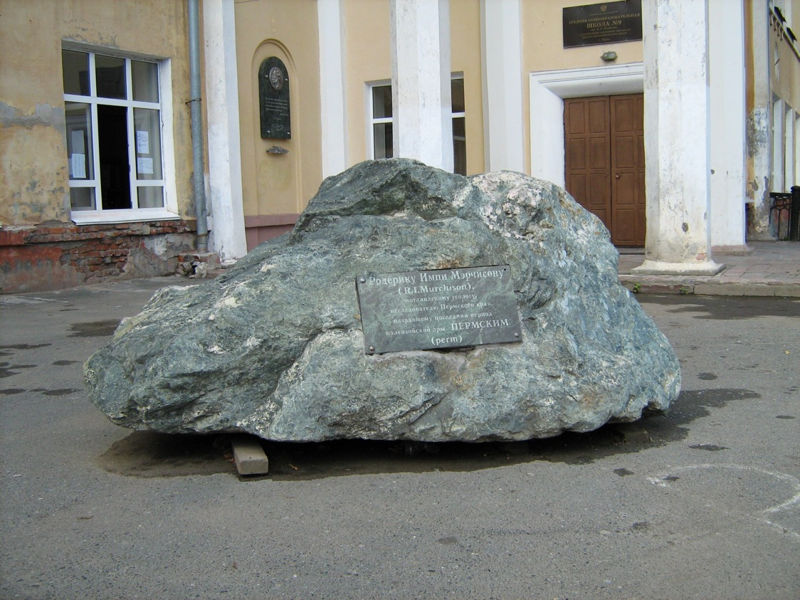
Murchison’s Urals
“To Roderick Impey Murchison, Scottish geologist, explorer of Perm Krai, who gives to the last period of the Palaeozoic era the name of Permian”
A memorial tablet was erected in 2005 in front of School #9 in Perm

Slide 10
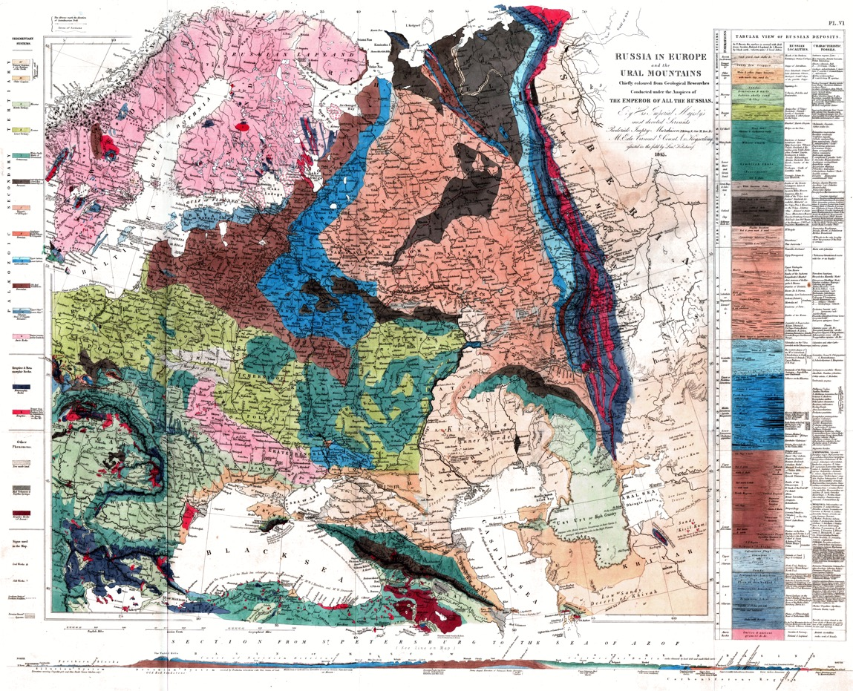
Murchison’s Map of 1845

Slide 11
Geological traverse – Taganai to Miass
Recognition of the largely Silurian nature of the rocks of the Urals
Recognition that they are deformed and metamorphosed
Recognised extensive sequences of limestones correlated with British sequences
Recognises extensive magmatic rocks closely related to ore formation

Slide 12
Geological traverse – Ural Tau to Katchkanar
He clearly described the Permian deformed foreland basin of the Uralides, location of the Main Urals Fault and magmatic rocks of the Tagil zone
He described the magmatic titano-magnetite deposit of Katchkanar and related platinum placer deposits

Slide 13
Geological traverse – Ural Tau to Verkny Uralsk
The deformed zone of the Main Urals fault is shown with associated serpentinites and lode gold deposits
Extensive jasper beds related to volcanic sequences of the Magnitogorsk zone

Slide 14
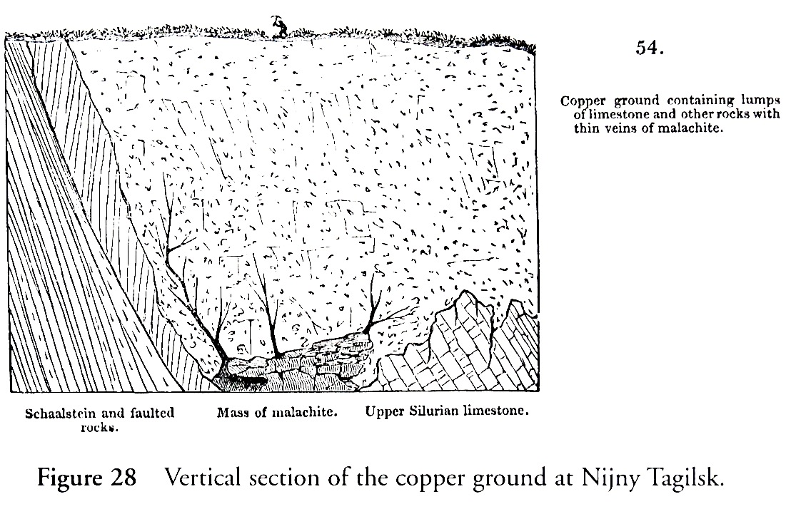
Many detailed geological observations
Malachite deposits of Nizhny Tagil

Slide 15
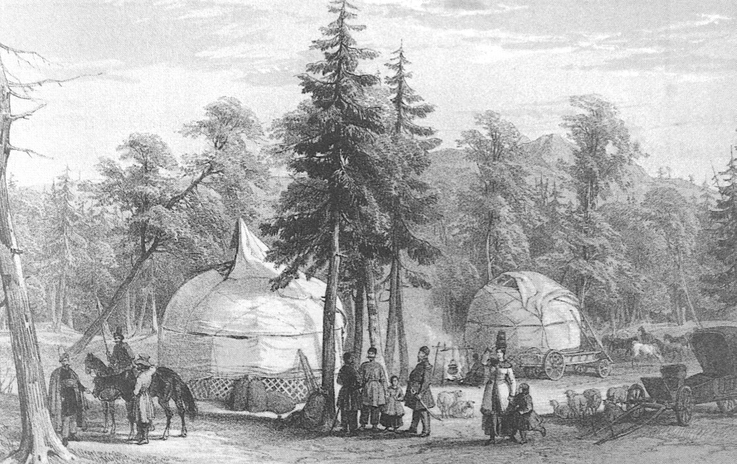
Many cultural observations
Overnight with Bashkirian people – Plate from Murchison’s book (1845)

Slide 16
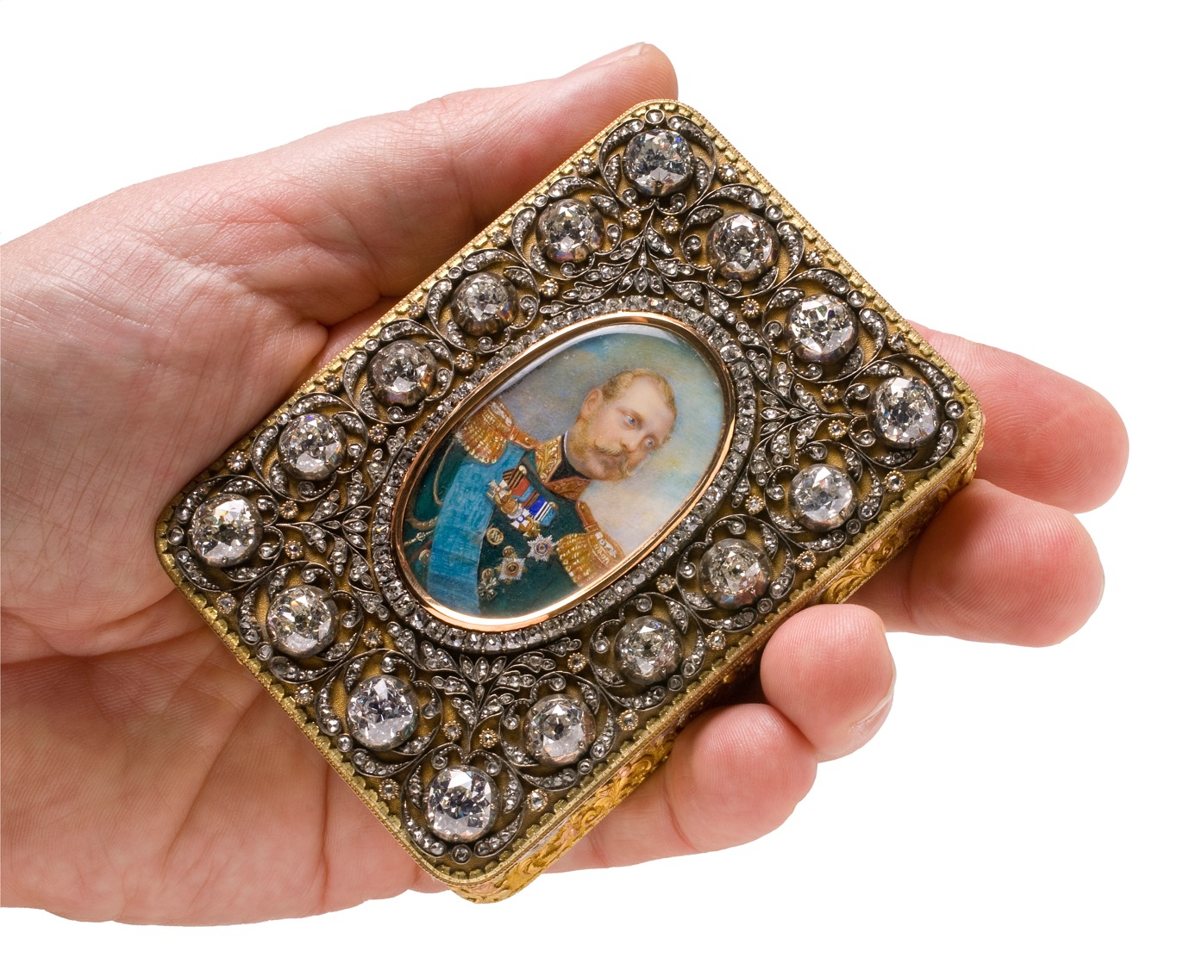

Slide 17
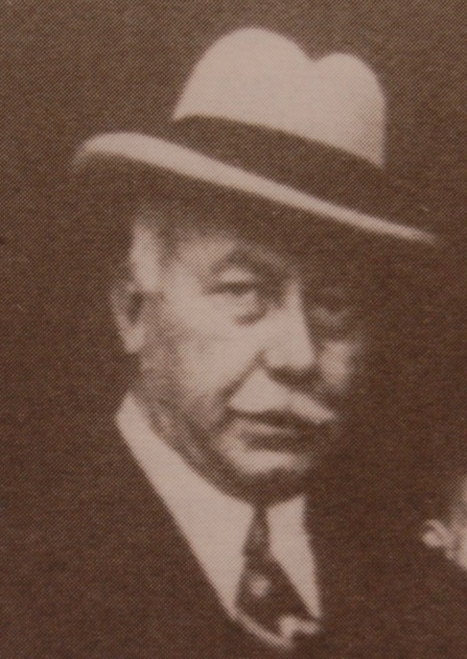
British business followed…..
Leslie Urquhart formed the Anglo-Siberian Company and in 1907 acquired the Kyshtim Mining Works which had been started by the Demidov family in 1757 (The Demidov’s were visited by Murchison in 1841)
Urquhart built an electrolytic copper plant at Kyshtim (only the second in the world) and he opened a new copper smelter at Lake Karabash in 1911 – both these operations are still running
He then moved on to develop more copper mines with the Tanalyk Corporation (Baimak area) and at Irtysh
Urquhart’s companies controlled 50% of Russian copper production until the 1917 revolution
Urquhart later went on to develop the Mt Isa Mine in Australia…

Slide 18
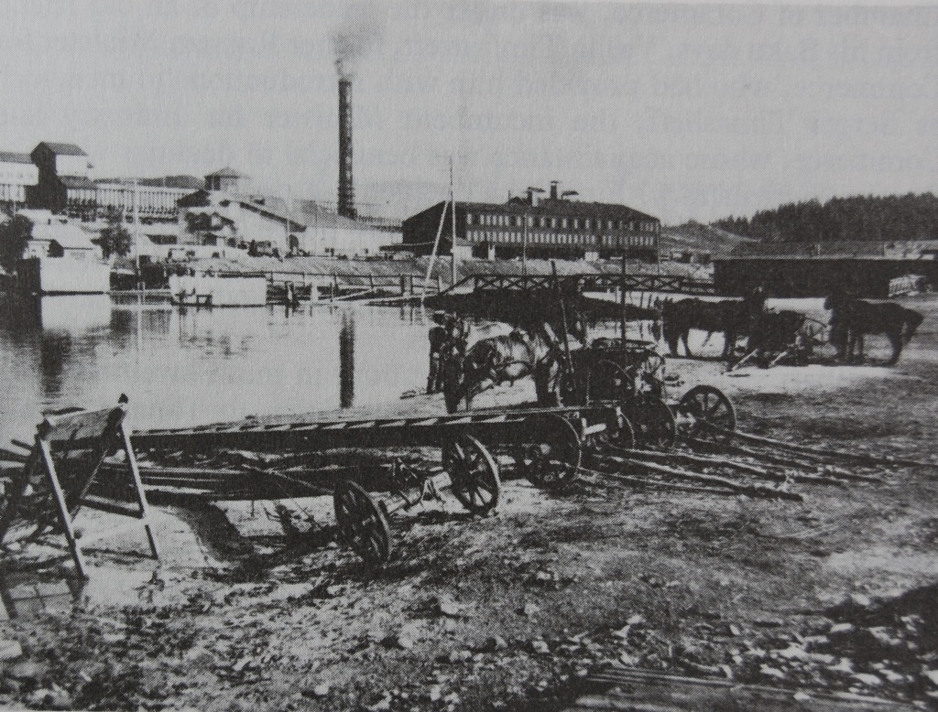
Karabash smelter in 1911

Slide 19
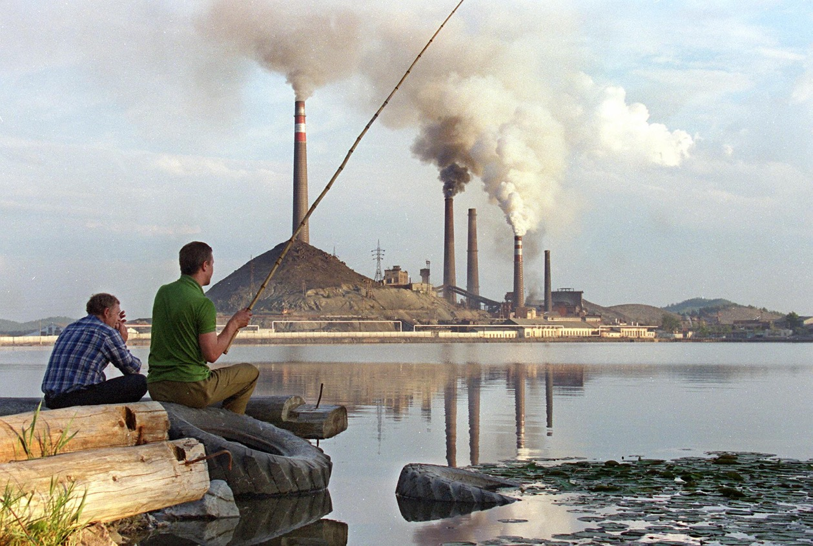
Karabash when NHM visited in 1996

Slide 20
NHM involvement since 1995
The importance of fossils found by Miass geologists associated with massive sulfide copper and zinc deposits was recognised in the literature
Together we revealed the world’s oldest known vent fauna community – published in Nature in 1997
Our geological work became integrated with the URSEIS international project begun 1995
Collaborative research funded by UK research council NERC, Royal Society, EU Inco Copernicus, INTAS involving many colleagues from the NHM
A new integrated model of ore deposits and geology was published in 2005 by the team with reference to the URSEIS results
A new special volume of Ore Geology Reviews international journal was published in 2017 focused on Urals ore deposits
A new research grant has been awarded by NERC in 2017 (£400k) partly to work on Urals fossil vent sites (R Herrington Co-I and V Maslennikov Project partner)

Slide 21
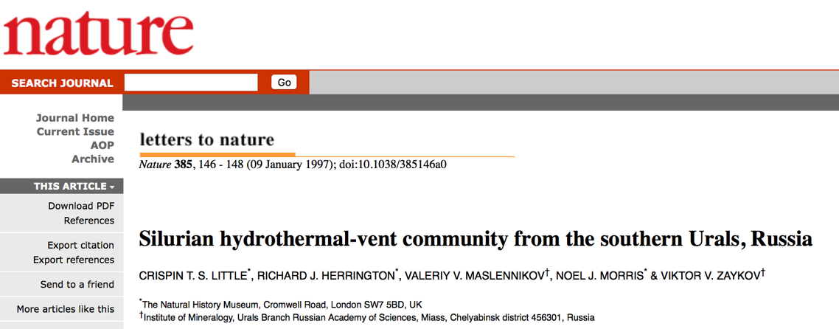
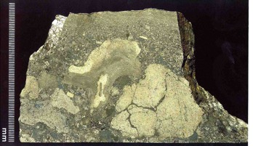
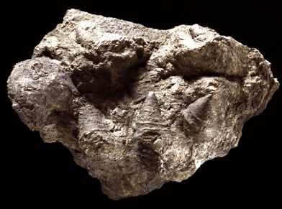
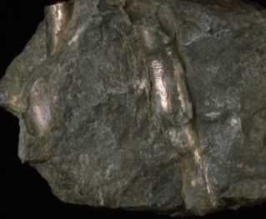
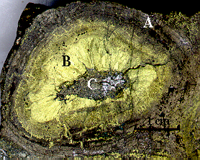
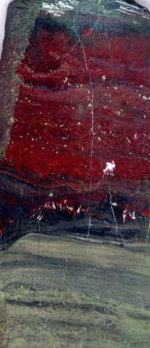
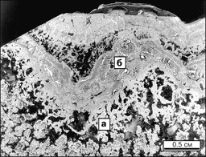
10m

Slide 22
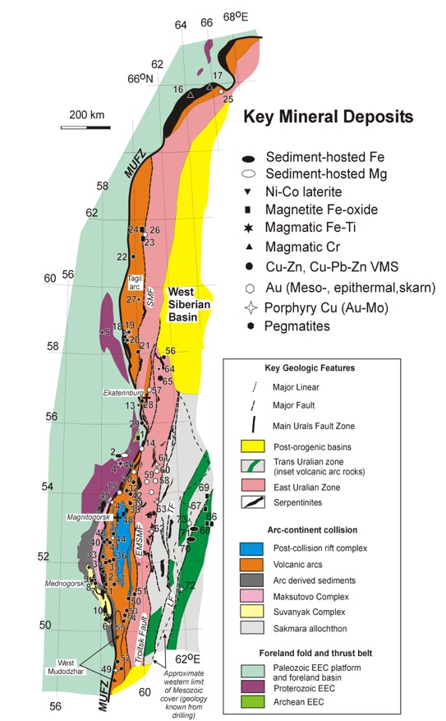
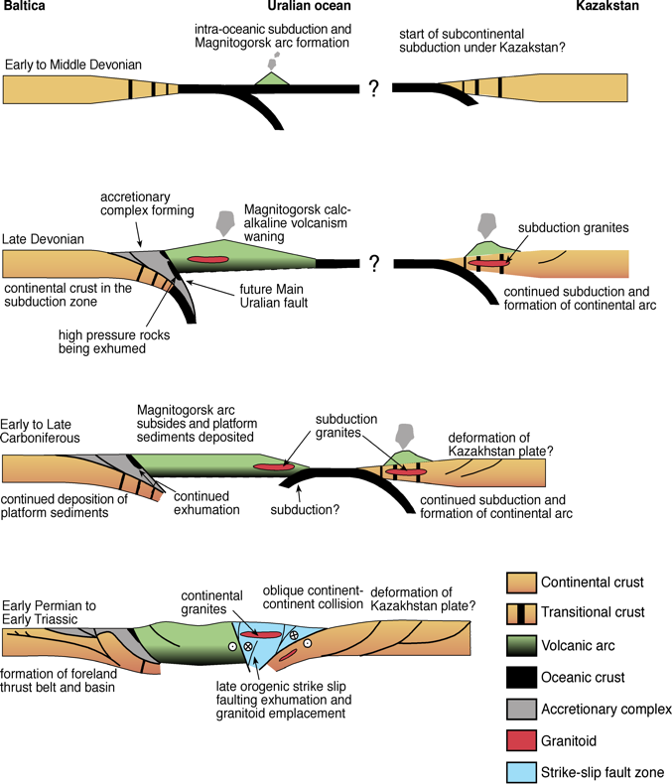
New ore deposit framework
Herrington et al. 2005

Slide 23
Correlations across the Urals
Herrington et al. 2005

Slide 24
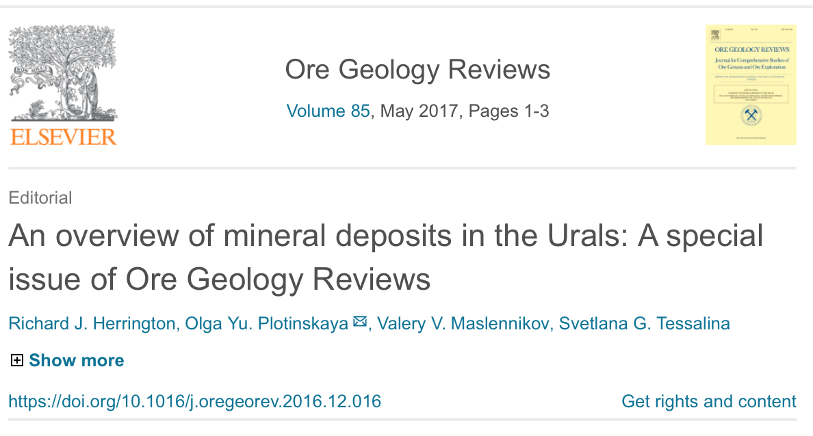
23 years on – work continues..

Slide 25
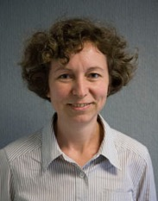
Important collaborations
A very big thanks to our Russian colleagues from the Institute of Mineralogy in Miass and RAS Ufa not here today
Victor Puchkov, Ufa;
Elena Belogub, Miass;
Svetlana Tesalina, Australia
Valeriy V. Maslennikov
Victor V. Zaykov

Slide 26
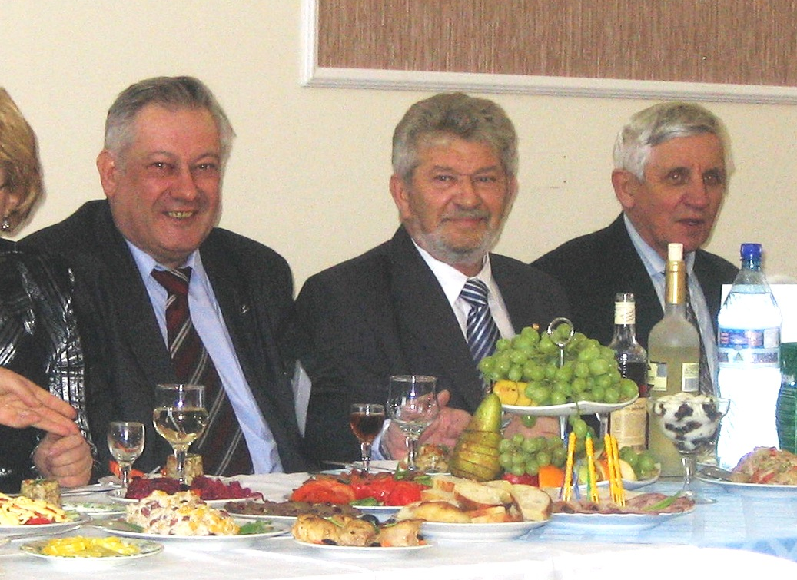
Important supporters
Important supporters of our Urals expeditions:
Bortnikov, Nikolay S. – Academician of RAS
Anfilogov, Vsevolod N. – Corresponding member of RAS, IM UB RAS
Koroteev Viktor A. - Academician of RAS

